Slide 1
Text Summarization
Presented By:
Sourabh Mathur
Stuti Chug
M.Tech CSE

Slide 2
Outlines Of Presentation
Motivation
Text summarization
Automatic text summarization
Methods of summarization
Text summarization process
Weighting scheme
Similarity measure
Evaluation measure for automatic extraction method
Text summarization using clustering
Web site summarization
References

Slide 3
Motivation
Exploit the classical IR precision and recall measures as similarity measure to promote text summarization.
Evaluates the performance of different similarity measure in the context of document summarization

Slide 4
Text Summarization
To extract the gist, the essence, of a text and present it in a shorter form with as little loss as possible with respect to mediated information

Slide 5
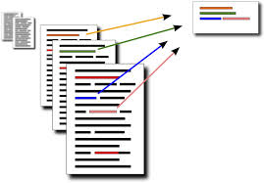
Automatic Text Summarization
Automatic Text Summarization is the technique where a computer program summarizes a text
The program is given a text and returns a shorter, hopefully non-redundant, text.

Slide 6
Methods For Summarization
EXTRACTION :
In Extractive Summarization , summary is generated by selecting a subset of existing words, phrases, or sentences in the original text to form the summary.

Slide 7

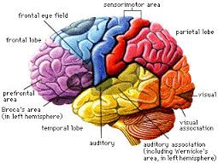
ABSTRACTION
Read the document
Understand them –build
semantic representation
Generate a summary from
this representation

Slide 8
Query Based Summarization and Generic Summarization
GENERIC SUMMARIZATION
Summarize the main topic and key content of the document
QUERY BASED SUMMARIZATION
Summarize a document with respect to an information need expressed in user query

Slide 9
Text Summarization Process
Decompose the document into individual sentences .
Rank all the sentence according relevance score
Highest relevance score sentences add to the summary
Compute similarity using similarity measure
Compute relevance score

Slide 10
Weighting Algorithm
QUERY TERM FREQUENCY (QTF)
Number of times the query term appear in a sentence.
QUERY TERM ORDER (QTO)
Number of time the query term appear with those term appear earlier in query being assigned higher score.

Slide 11
Weighting Scheme
TF (term frequency):
tf_{t,s} means number of times term t appear in sentence s.
ISF(inverse sentence frequency):
inverse sentence frequency, number of sentences in which the term occurs divided with the total number of sentences
ISF_{t}=log(N|N_{t})
N_{t} = Total number of sentence in document d.
N = Number of sentences that contain term t.

Slide 12
TF-ISF(Term frequency-Inverse sentence frequency) :
It is derived from well known weighting scheme TF-IDF.
It is the product of its tf weight and its isf weight.
w_{ij} = TF_{ij} .ISF_{i} = TF_{ij} .log(N/ N_{i})

Slide 13

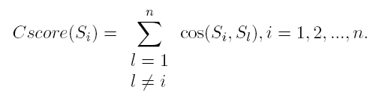
Cosine Similarity
w_{ij} =weight of the term t_{j} in the sentence s_{i}

Slide 14
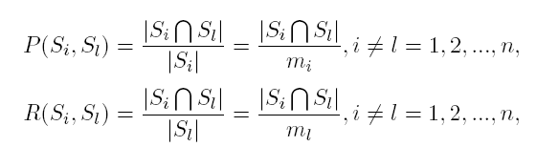

F-Measure

Slide 15
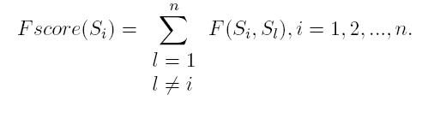

Slide 16
Evaluation Measure for automatic extraction method (CR=30%)
Document | Cosine Similarity | F - Measure | MS word summarizer | Copernic summarizer
Doc - 1 | 0.1739130 | 0.2608695 | 0.0909090 | 0.086956521
Doc - 2 | 0.21621621 | 0.21621621 | 0.1818181 | 0.060606
Doc - 3 | 0.2222 | 0.2222 | 0.2 | 0.2222

Slide 17

Text summarization using clustering
Step 1 -> Decompose the document into sentences
D = (S₁ , S₂ ……S_{N} )
Step 2 ->Partition the sentences into k clusters
such that:
C = (C₁ , C₂ …..C_{K} )
C_{K} ≠ ϕ for i=1,2……k
C_{k} ∩ C_{l} = ϕ for k=1,….k , l=1,…k & k≠l

Slide 18


x_{ik} = 1 , if s_{i} belong to cluster c_{k}
0, otherwise .

Slide 19


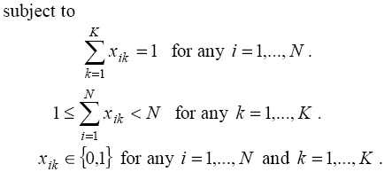

Slide 20


Step 3-> Find relevance score of the sentences:
Then score of relevance of the sentence Si :
Where weights β 1 ,β 2 ∈[0,1] and β ₁+β ₂ =1

Slide 21

Step 4 -> Sentence selection for summary:
the sentences are included into summary starting with the highest score of relevance. This process continues up to the points when
compression rate ratecomp satisfies limit set.

Slide 22
Web site summarization
URL Extraction
Text Extraction
Narrative text classification
Key phrase extraction
Key sentence extraction
Website Summary

Slide 23
Graph representation of web site
Home
About us
UG
PG
Academics
Admissions
Students
Advertorial
DASA Admissions
Placements

Slide 24
References
[1] Rasim M. Alguliev , Ramiz M. Aliguliyev : experimental investigating the f -measure as similarity measure for automatic text summarization appl. comput. math., vol.6, no.2, 2007
[2] Aliguliyev, R.M., A novel partitioning-based clustering method and generic document summarization, Pro-ceedings of the 2006 IEEE/WIC/ACM International Conference on Web Intelligence and Intelligent Agent
Technology (WI-IAT 2006 Workshops) (WI-IATW'06), Hong Kong, China, 18-22 December, 2006, p.626-629.
[3] Y. Zhang, N. Zincir-Heywood, E. Milios: “World Wide Web Site Summarization", to appear in Web Intelligence and Agent Systems: An International Journal (The Web Intelligence Consortium), 2(1), pages 39-53, 2004.

Slide 25
Thank You

